Slide 1
A PRESENTATION ON
Off-Street Car Detection Algorithm for Smart Parking
By :-
KUNAL SANGHVI [011809708]

Slide 2
Introduction
There is increase in number of vehicles and mismanagement of parking spaces.
There is an utmost need to develop a smart parking system which would help an individual to find empty parking slot.

Slide 3
Introduction
Most of the smart parking system still rely on sensor-based approach.
Thus, a prototype of Camera based Smart Parking System is proposed, which detects live empty parking slots and notifies it through a user-friendly Android application.

Slide 4
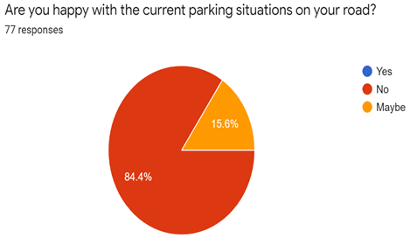
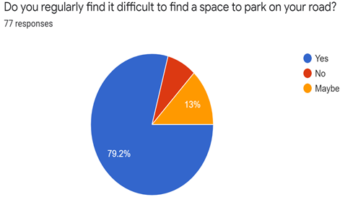
Survey

Slide 5
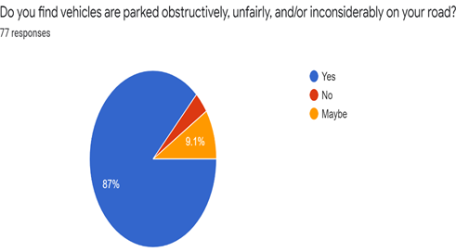
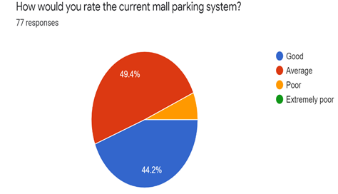
Survey

Slide 6
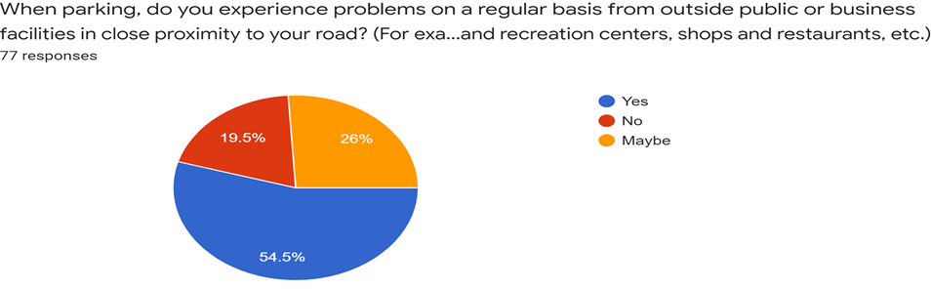
Survey

Slide 7
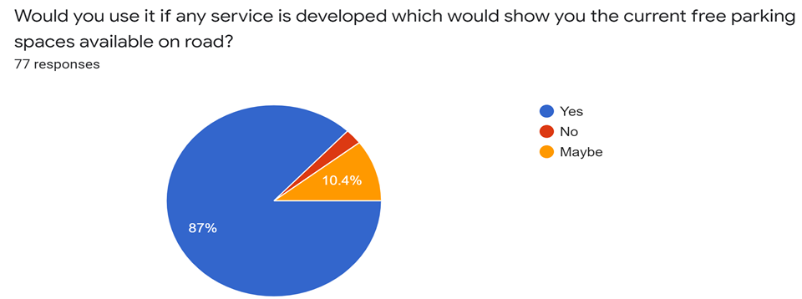
Survey

Slide 8
Problem Statement
The parking solutions for on street and off street parking is the need of today's time, thus initially to showcase the robust nature of the system we are targeting off street parking i.e.
1)Housing societies
2)Malls
3)Individual organizations
4)Parking Lots

Slide 9
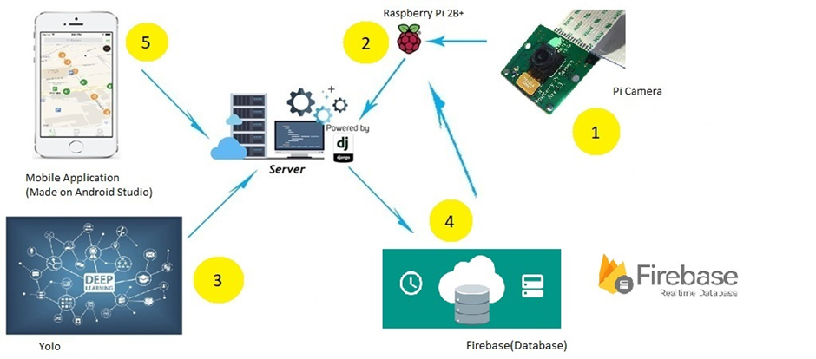
System Design

Slide 10
Algorithm
No
Give video feed to the deep learning algorithm
Is any car detected?
Take live video frame from camera
START
Yes
Coordinates are matched?
No
STOP
Update the database
Yes

Slide 11
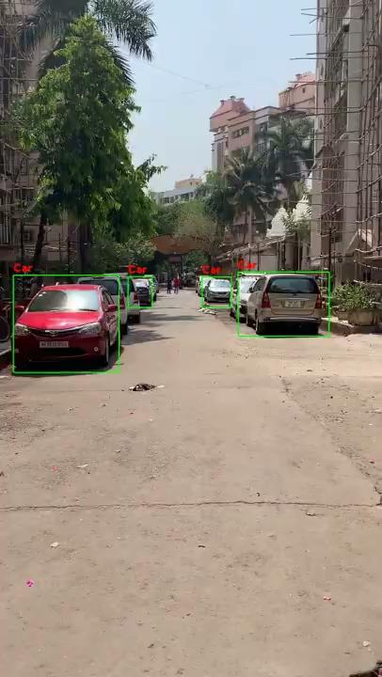

Project Demonstration

Slide 12
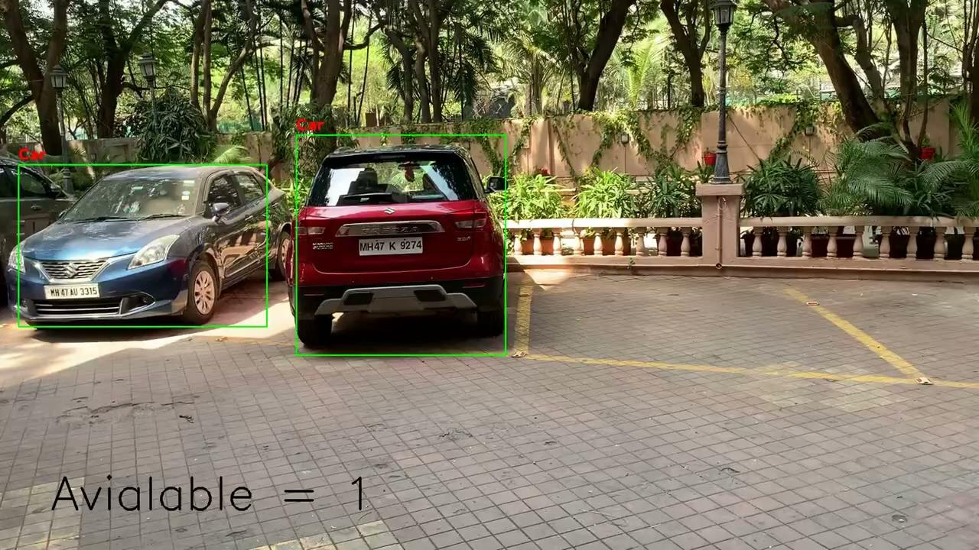
Project Demonstration

Slide 13
Project Demonstration

Slide 14
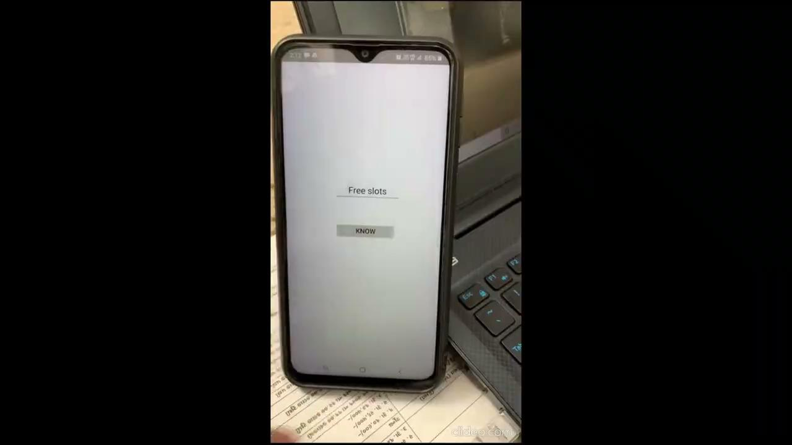
Project Demonstration

Slide 15
Future aspects
Accuracy of the model can be further increased by training it with more images and varying parameters of the model.
Hardware compatibility can be eradicated by using CCTV camera and server computer.
This system can be integrated with reservation and charging of parking slots for malls and various independent organizations.

Slide 16
Thank You

Slide 17
Questions?

